Slide 1

USWDS Monthly Call
January 2024

Slide 2

Hi!
Thanks for being here!

Slide 3
Agenda
Product updates
The USWDS Basics
Q&A

Slide 4
Product updates

Slide 5
USWDS 3.12.0
Out next week

Slide 6
Notable updates in USWDS 3.12.0
Minimum heading count for in-page navigation. Adds a setting to hide the nav when the content region doesn’t contain a minimum number of headings
Allow tooltips on non-button elements.
Resolves vulnerability warning for unescaped strings. Refactors a toggle function to address a non-exploitable vulnerability that may trigger code scanning warnings

Slide 7
New accessibility test pages
Date picker
Date range picker
Alert
Site alert
Next: Step indicator, Card, Modal, Range slider

Slide 8
USWDS for Figma
Updated uswds-for-designers with Figma design kit

Slide 9
Public discussions
Active discussions: Star rating component
Accessibility: Helpful accessibility resources

Slide 10
USWDS Elements Beta
New beta package and new ADRs

Slide 11
Signed commit requirement
Contributors need signed commits for consideration

Slide 12
USWDS Basics

Slide 13
Anne Petersen
they/them
Experience Design Lead USWDS

Slide 14
Matt Henry
he/him
Engineering Lead USWDS

Slide 15
Why use USWDS?

Slide 16
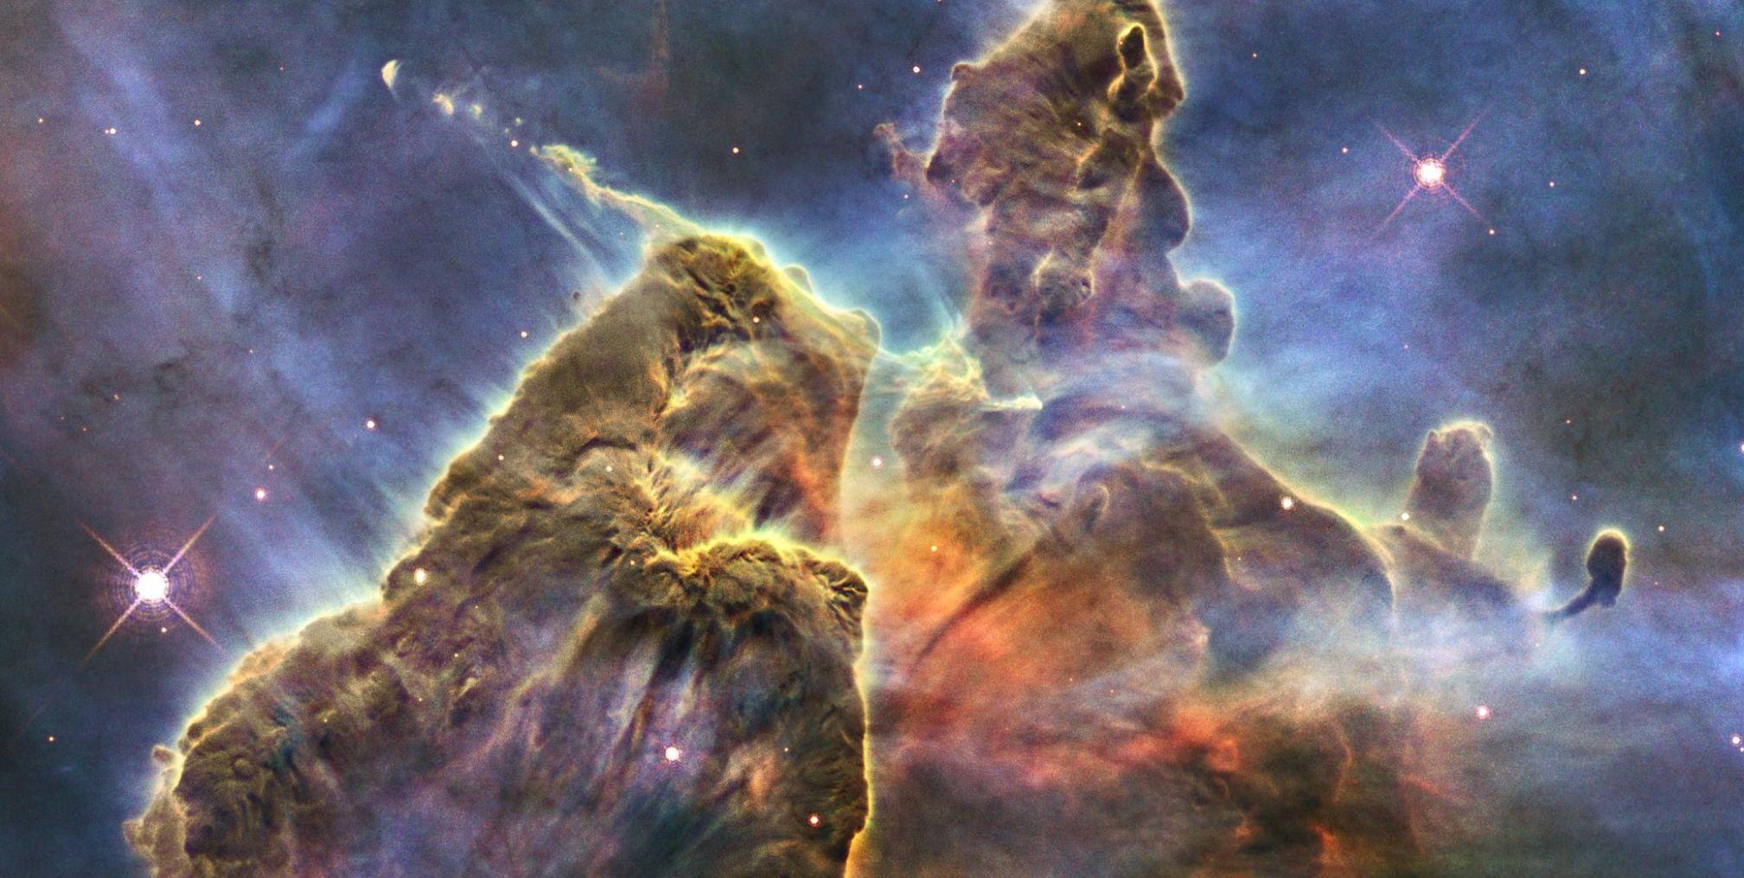
Way back.
Credit: NASA/ESA/STScl
Notes:
[AP] [beat] Or a lot back. Way back.To the cold vastness of space…

Slide 17
“If you wish to make an apple pie from scratch, you must first invent the universe.”
Carl Sagan

Slide 18
Difficult work.
Credit: NASA/ESA/STScl

Slide 19
Too many constraints?

Slide 20
Too few?
Credit: NASA/ESA/STScl

Slide 21
“I work better with a box of constraints. The constraints help me keep track of everything.”

Slide 22
“You’ve got this small set of building blocks. Once those are established, it’s so easy to build.”

Slide 23
A design system is a toolkit that supports design and development problem solving at scale.

Slide 24
Like a hardware store for building digital products

Slide 25
A design system provides…
Paint
Lumber
Doors
Cabinets
Smoke detectors
Sinks
Color palettes
Buttons
Headers
Form inputs
Alerts
Icons

Slide 26
Building a good button or an icon is a solved problem.

Slide 27
We help teams focus their time on
high-value unsolved problems.

Slide 28
USWDS is a tool to share, improve, and record what we know.

Slide 29
Our mission
Shaping the future of government digital services

Slide 30
Our vision
Empowered and supported
digital service teams.
Familiar and easy-to-use digital services.

Slide 31
Our polestar
We help government teams align, design, and keep their websites and services up to date

Slide 32
Since 2015. 🎉 (That’s ten years!?!)

Slide 33
Over 500 websites.
Over a billion pageviews.
1 in 5 government sessions.

Slide 34
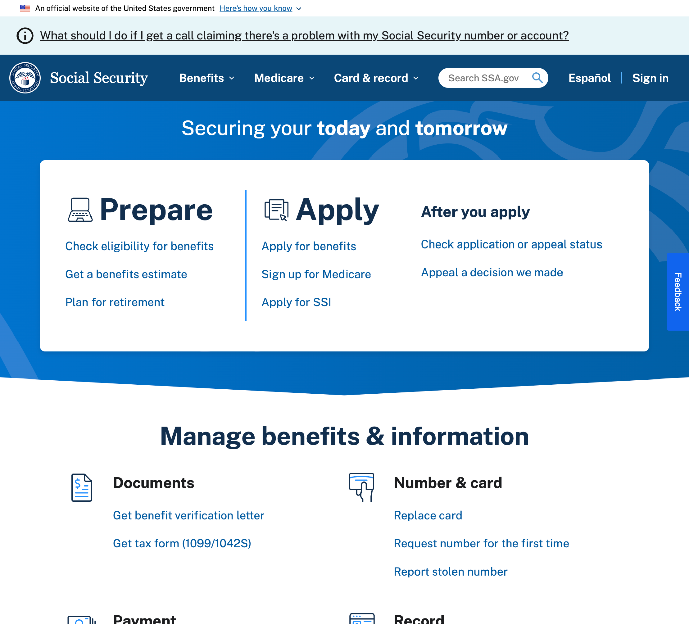
U.S. Social Security Administration
ssa.gov

Slide 35
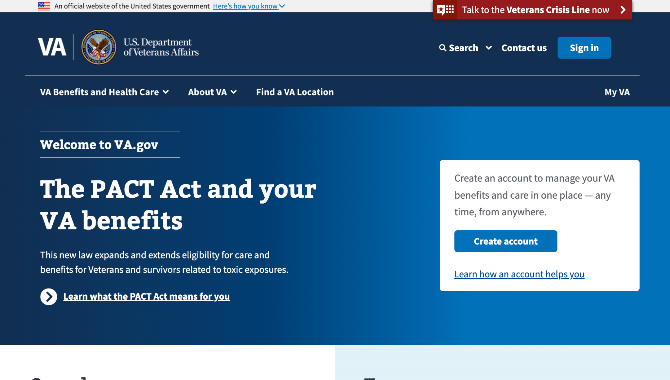
U.S. Department of Veterans Affairs
va.gov

Slide 36
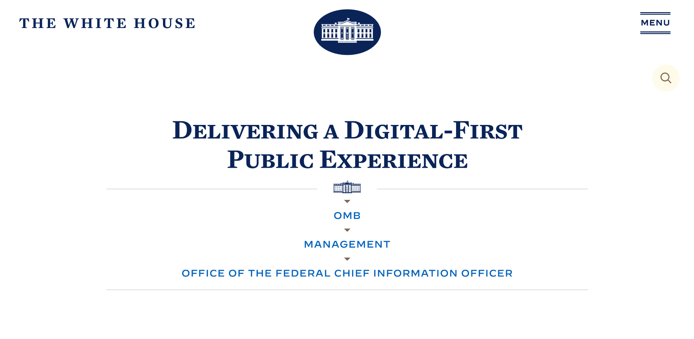
Delivering a digital-first public experience

Slide 37
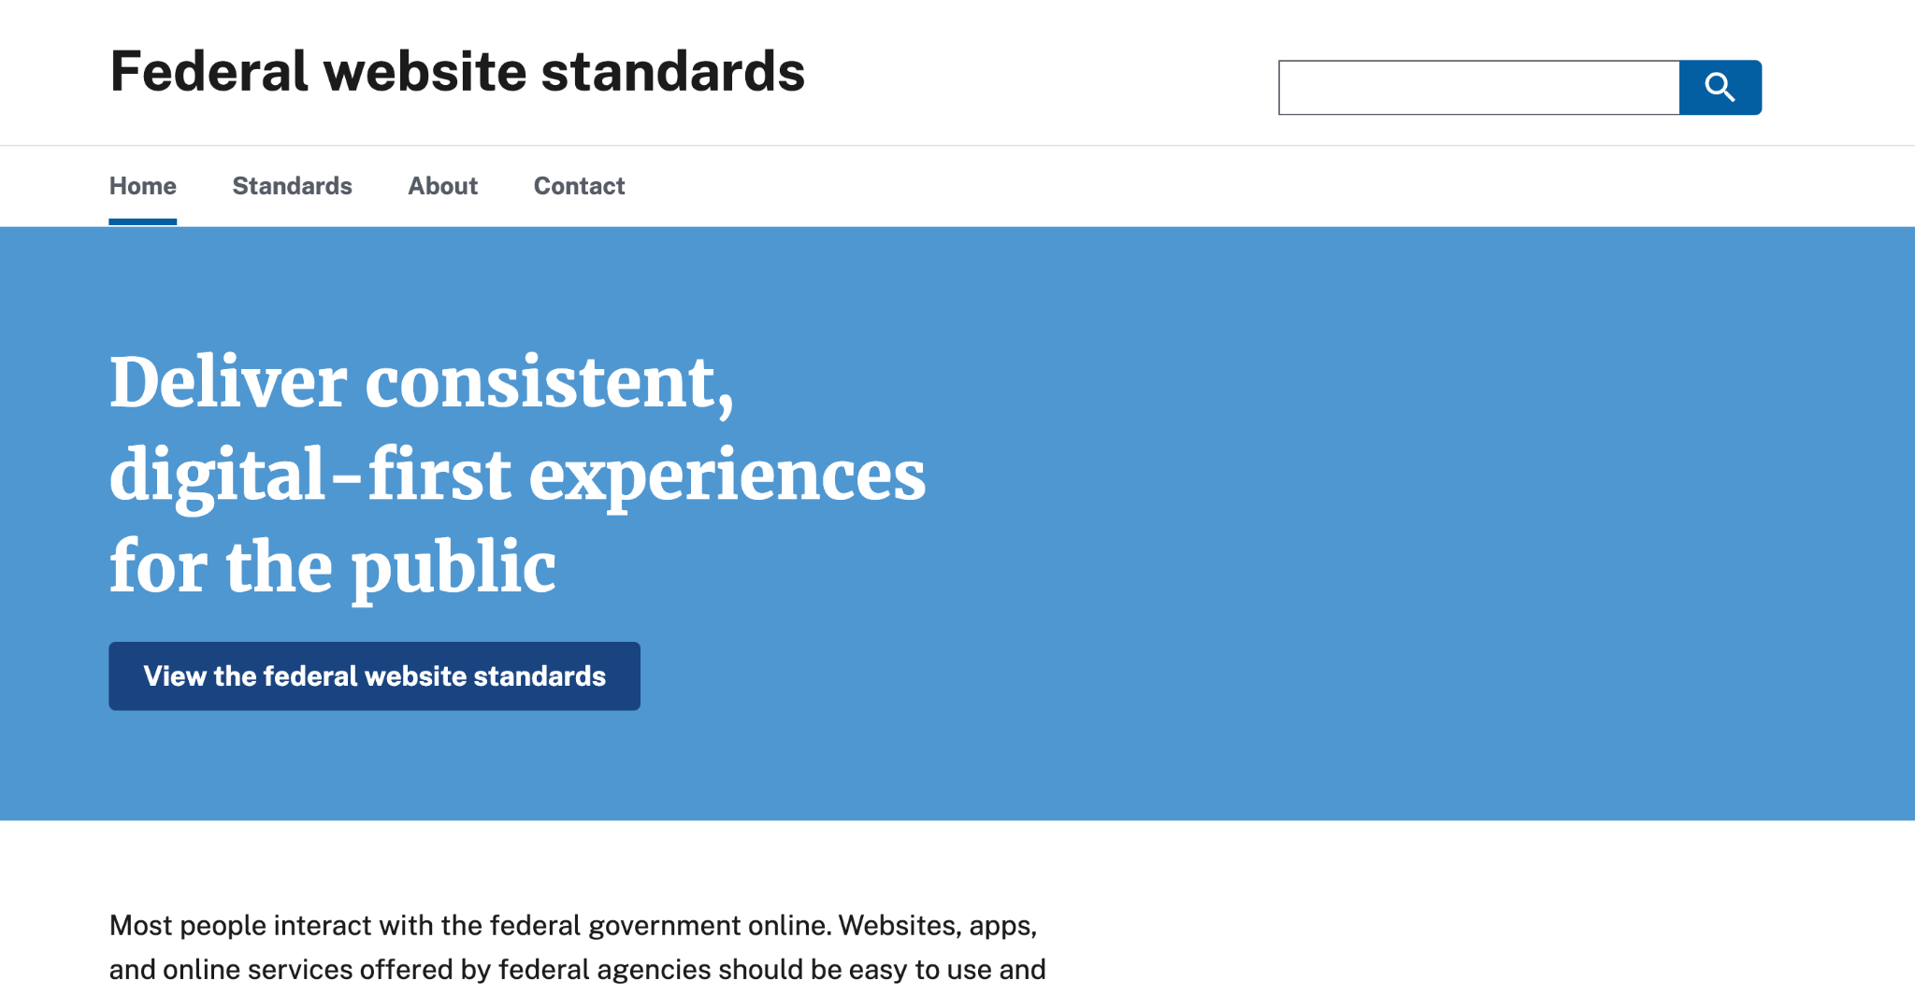
Federal Website Standards

Slide 38
Consistency.
A common design language.

Slide 39
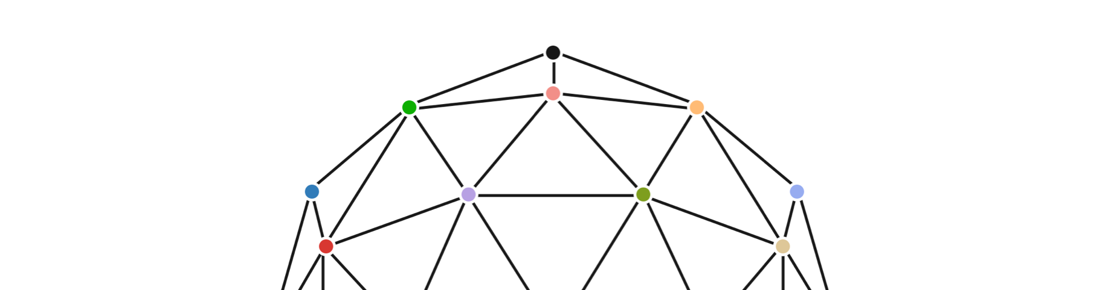
Principles

Slide 40
Design principles
Start with real user needs.
Earn trust.
Embrace accessibility.
Promote continuity.
Listen.

Slide 41
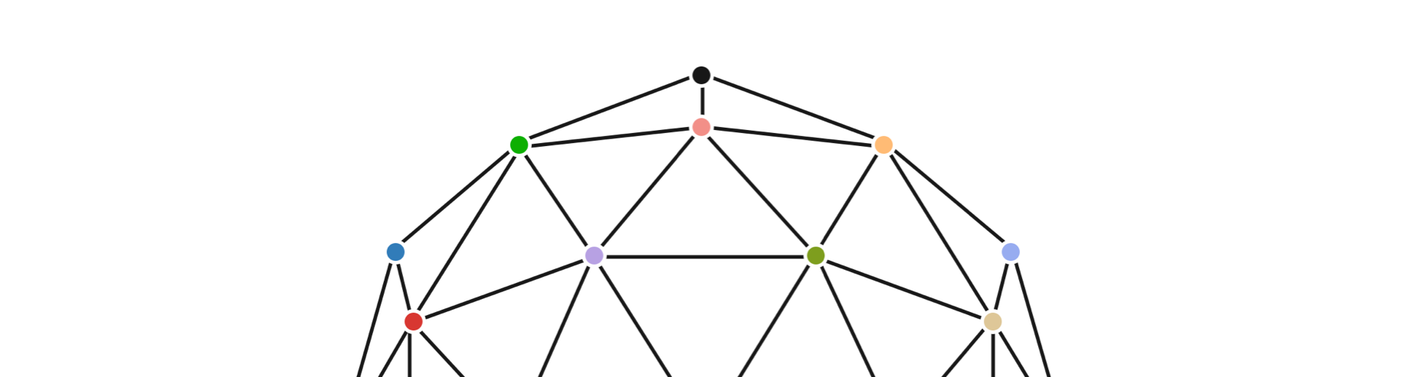
Patterns
Interactions

Slide 42
Pattern guidance for 17 patterns
Provide a name
Provide a date of birth
Provide an address
Provide an email address
Provide a phone number
Provide a gender identity or sex
Provide pronouns
Provide their race and ethnicity
Provide a Social Security Number
Provide contact preferences
Understand expectations and build trust in complex forms
Progress smoothly through complex forms
Keep a record of submitted form information
Indicate language preference
Select from two site languages
Select from three or more site languages
Find selected multilingual content

Slide 43
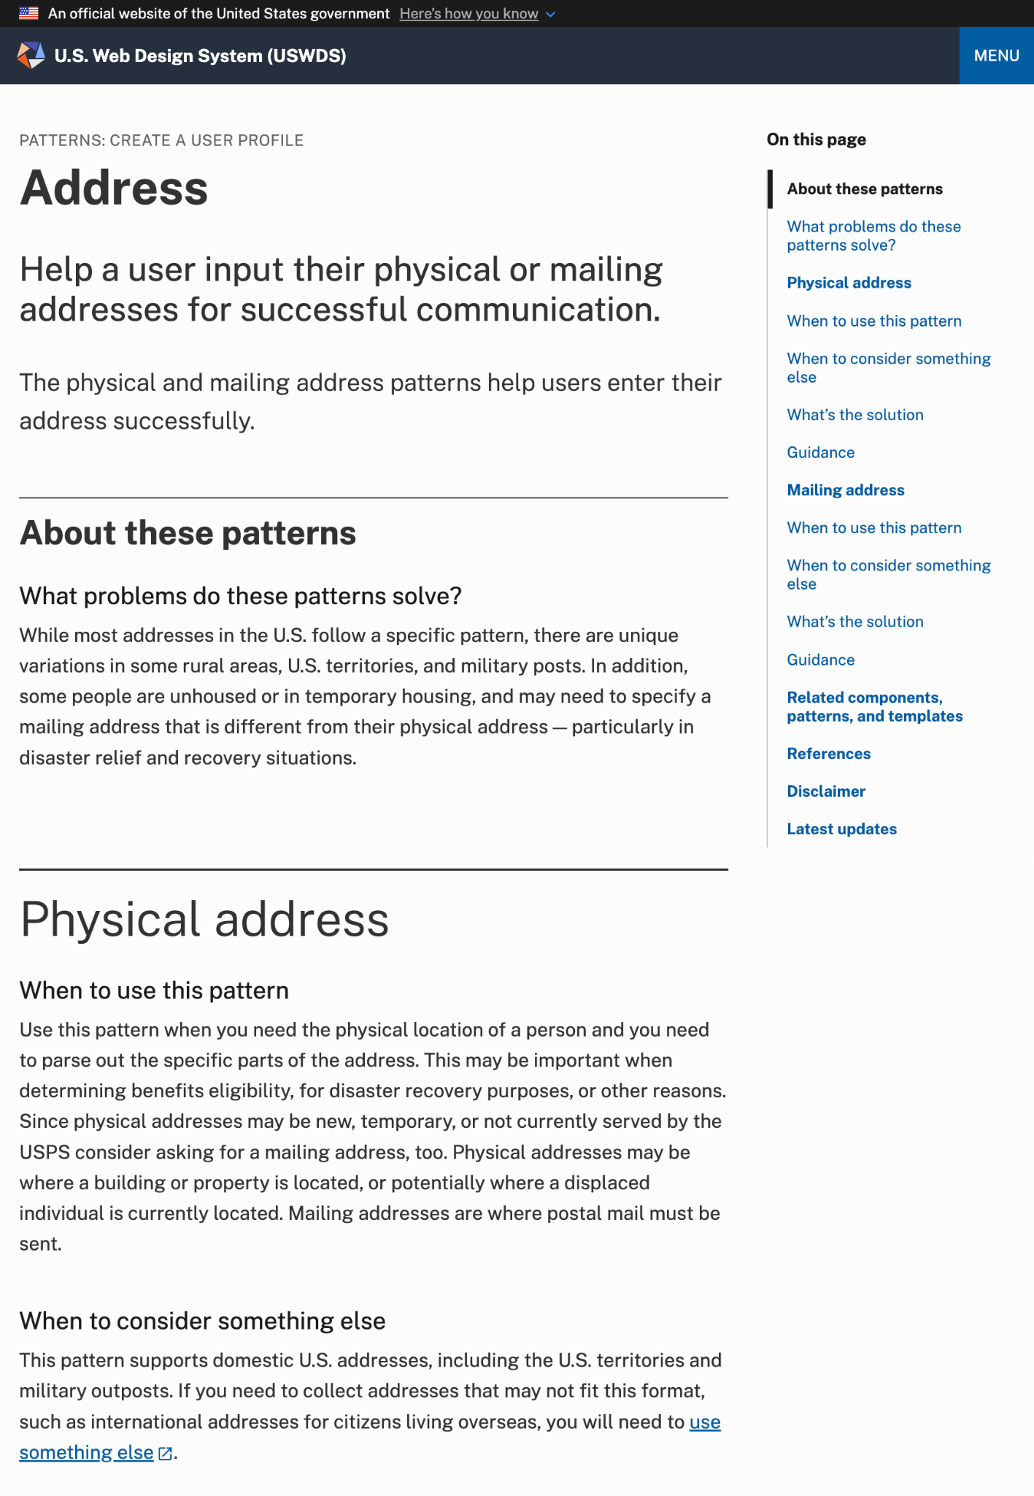
Description and problems solved
Address pattern

Slide 44
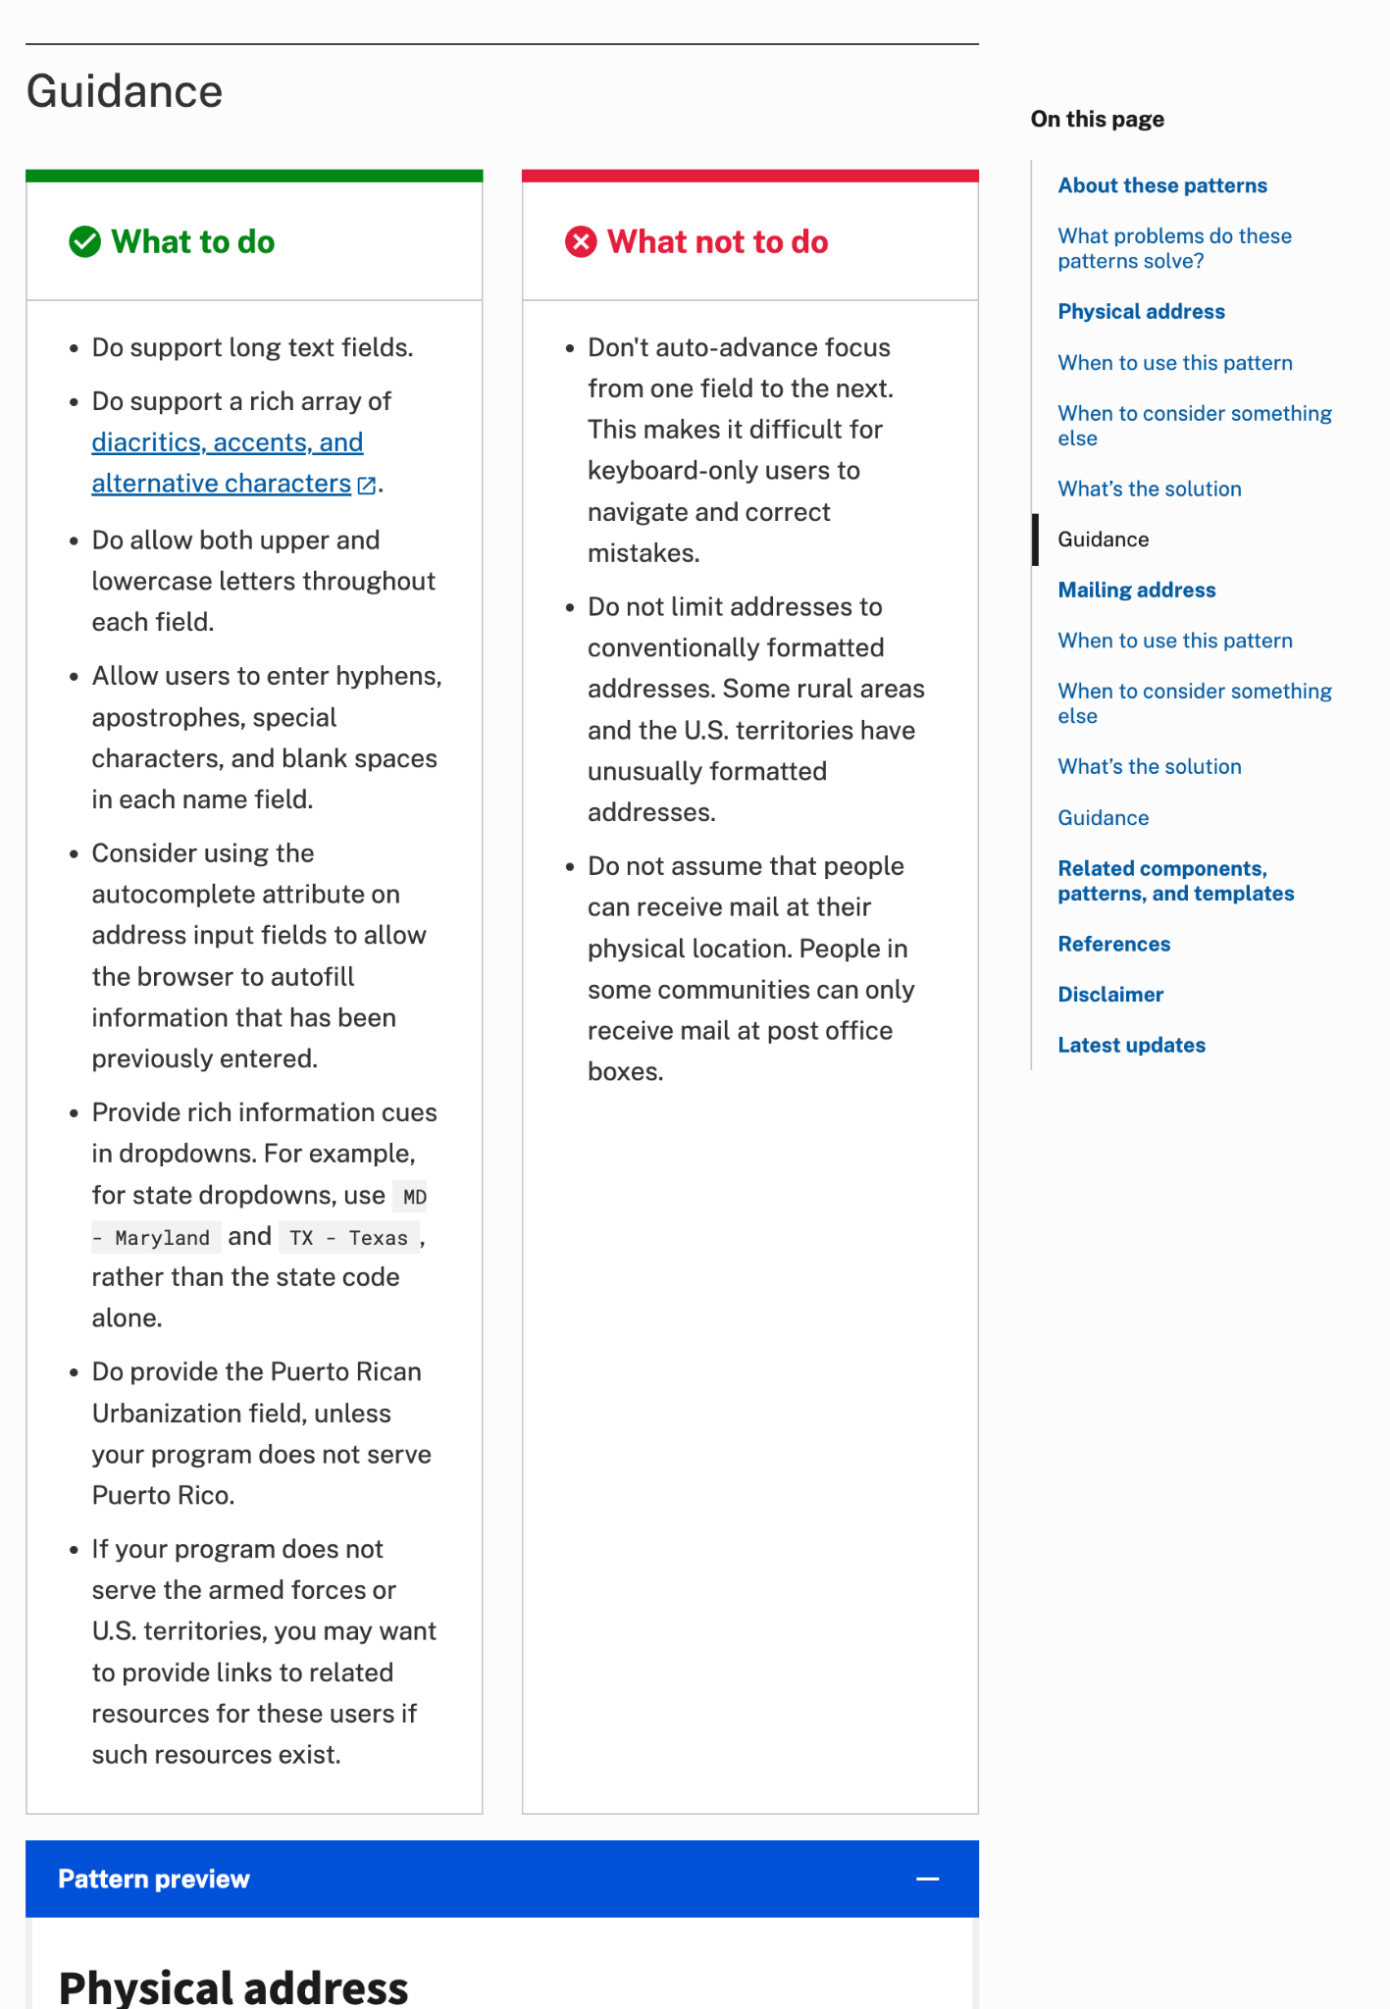
What to do and what not to do
Address pattern

Slide 45
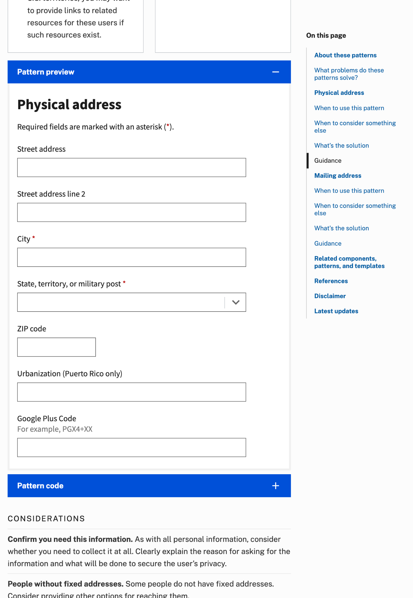
Pattern previews and templates
Address pattern

Slide 46
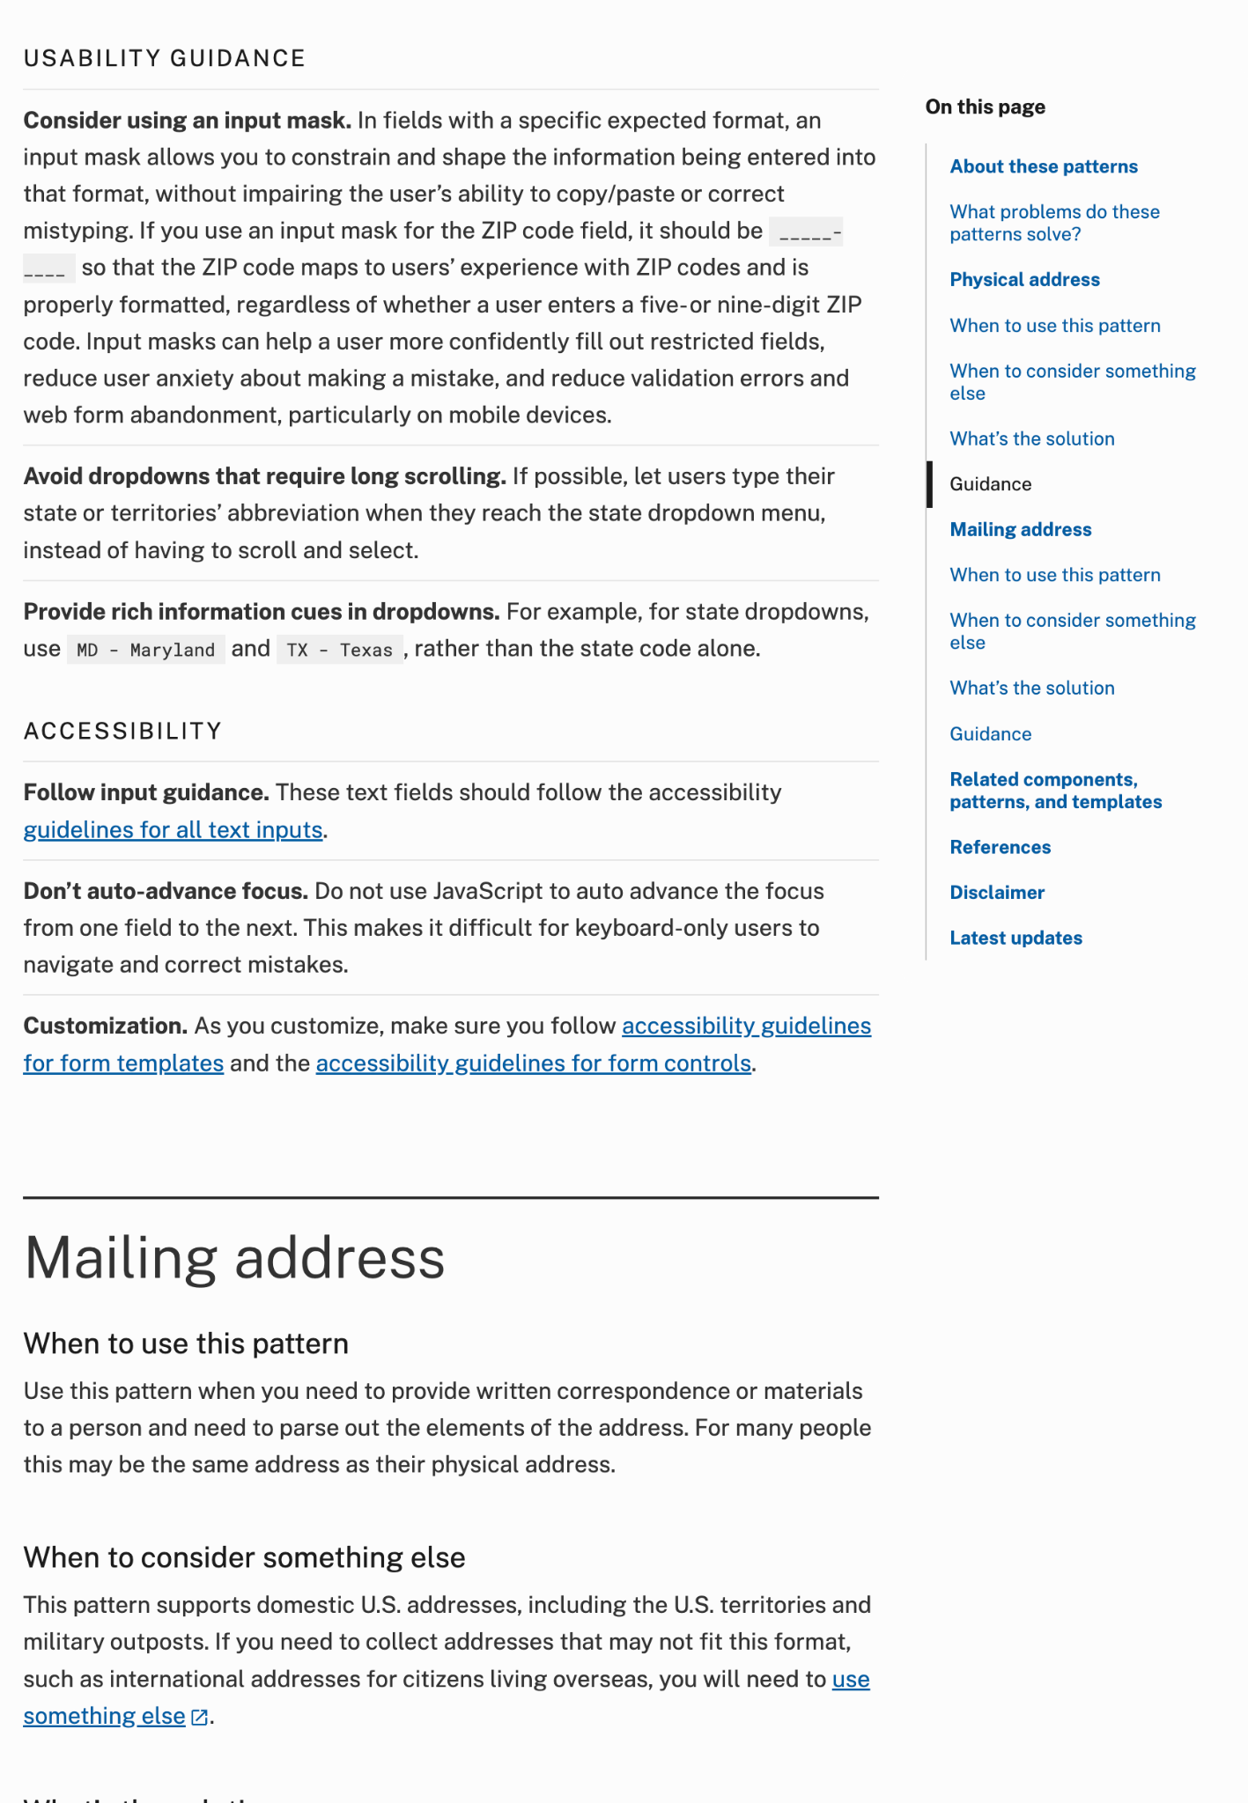
Usability guidance
Address pattern

Slide 47
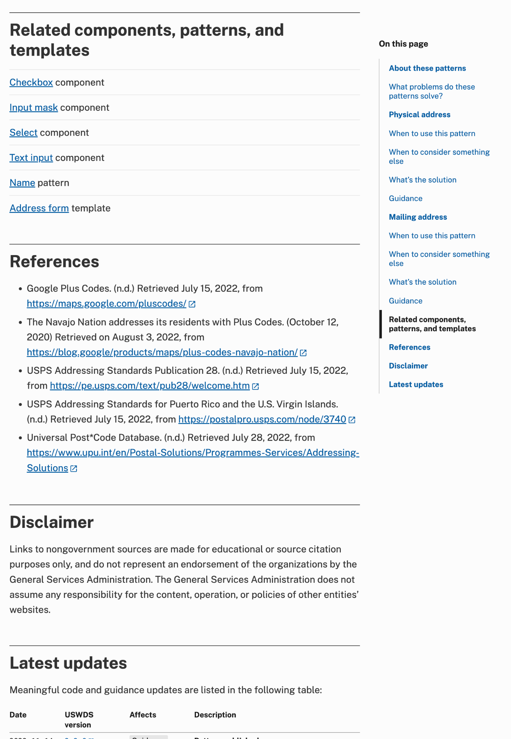
Pattern usability guidance
Address pattern

Slide 48
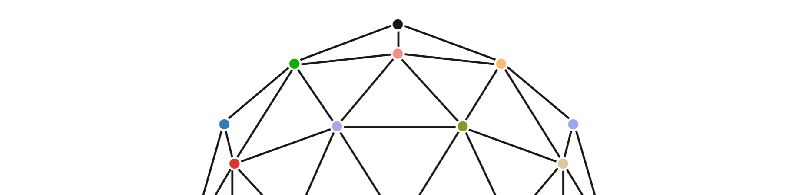
Components
Code, guidance, and accessibility tests

Slide 49
48 common components and usability guidance
Accordion
Alert
Banner
Breadcrumb
Button
Button group
Card
Character count
Checkbox
Collection
Combo box
Data viz
Date picker
Date range
File input
Footer
Form
Grid
Header
Icon
Icon list
Identifier
In-page nav
Input mask
Input prefix/suffix
Language selector
Link
List
Memorable date
Modal
Pagination
Process list
Prose
Radio buttons
Range slider
Search
Select
Side nav
Site alert
Step indicator
Summary box
Table
Tag
Text input
Time picker
Tooltip
Typography
Validation

Slide 50
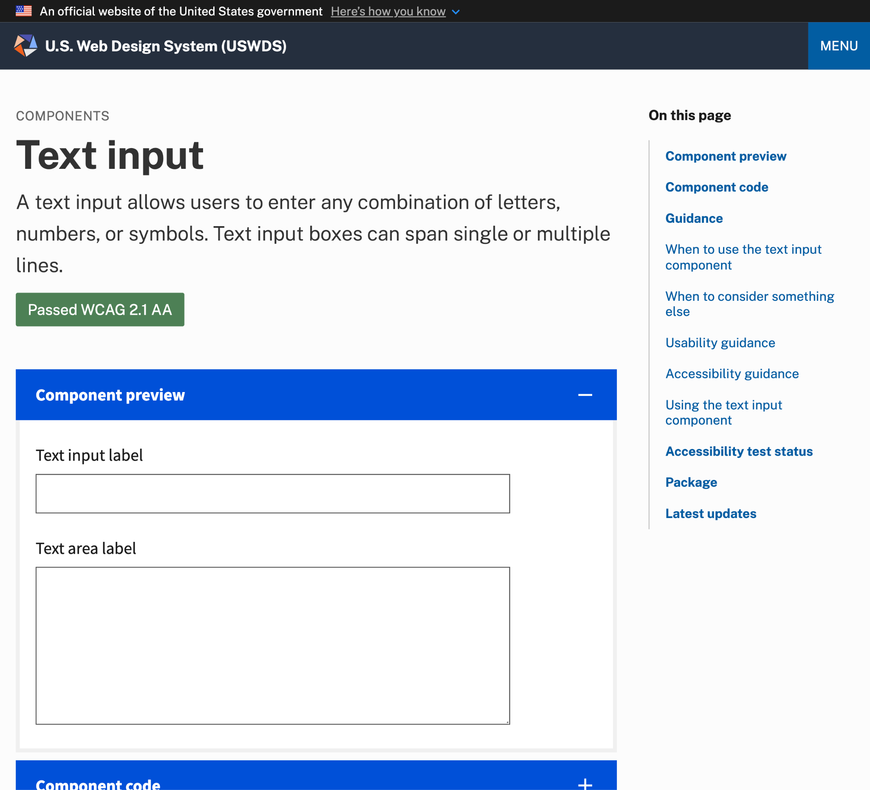
Description and preview
Text input component

Slide 51
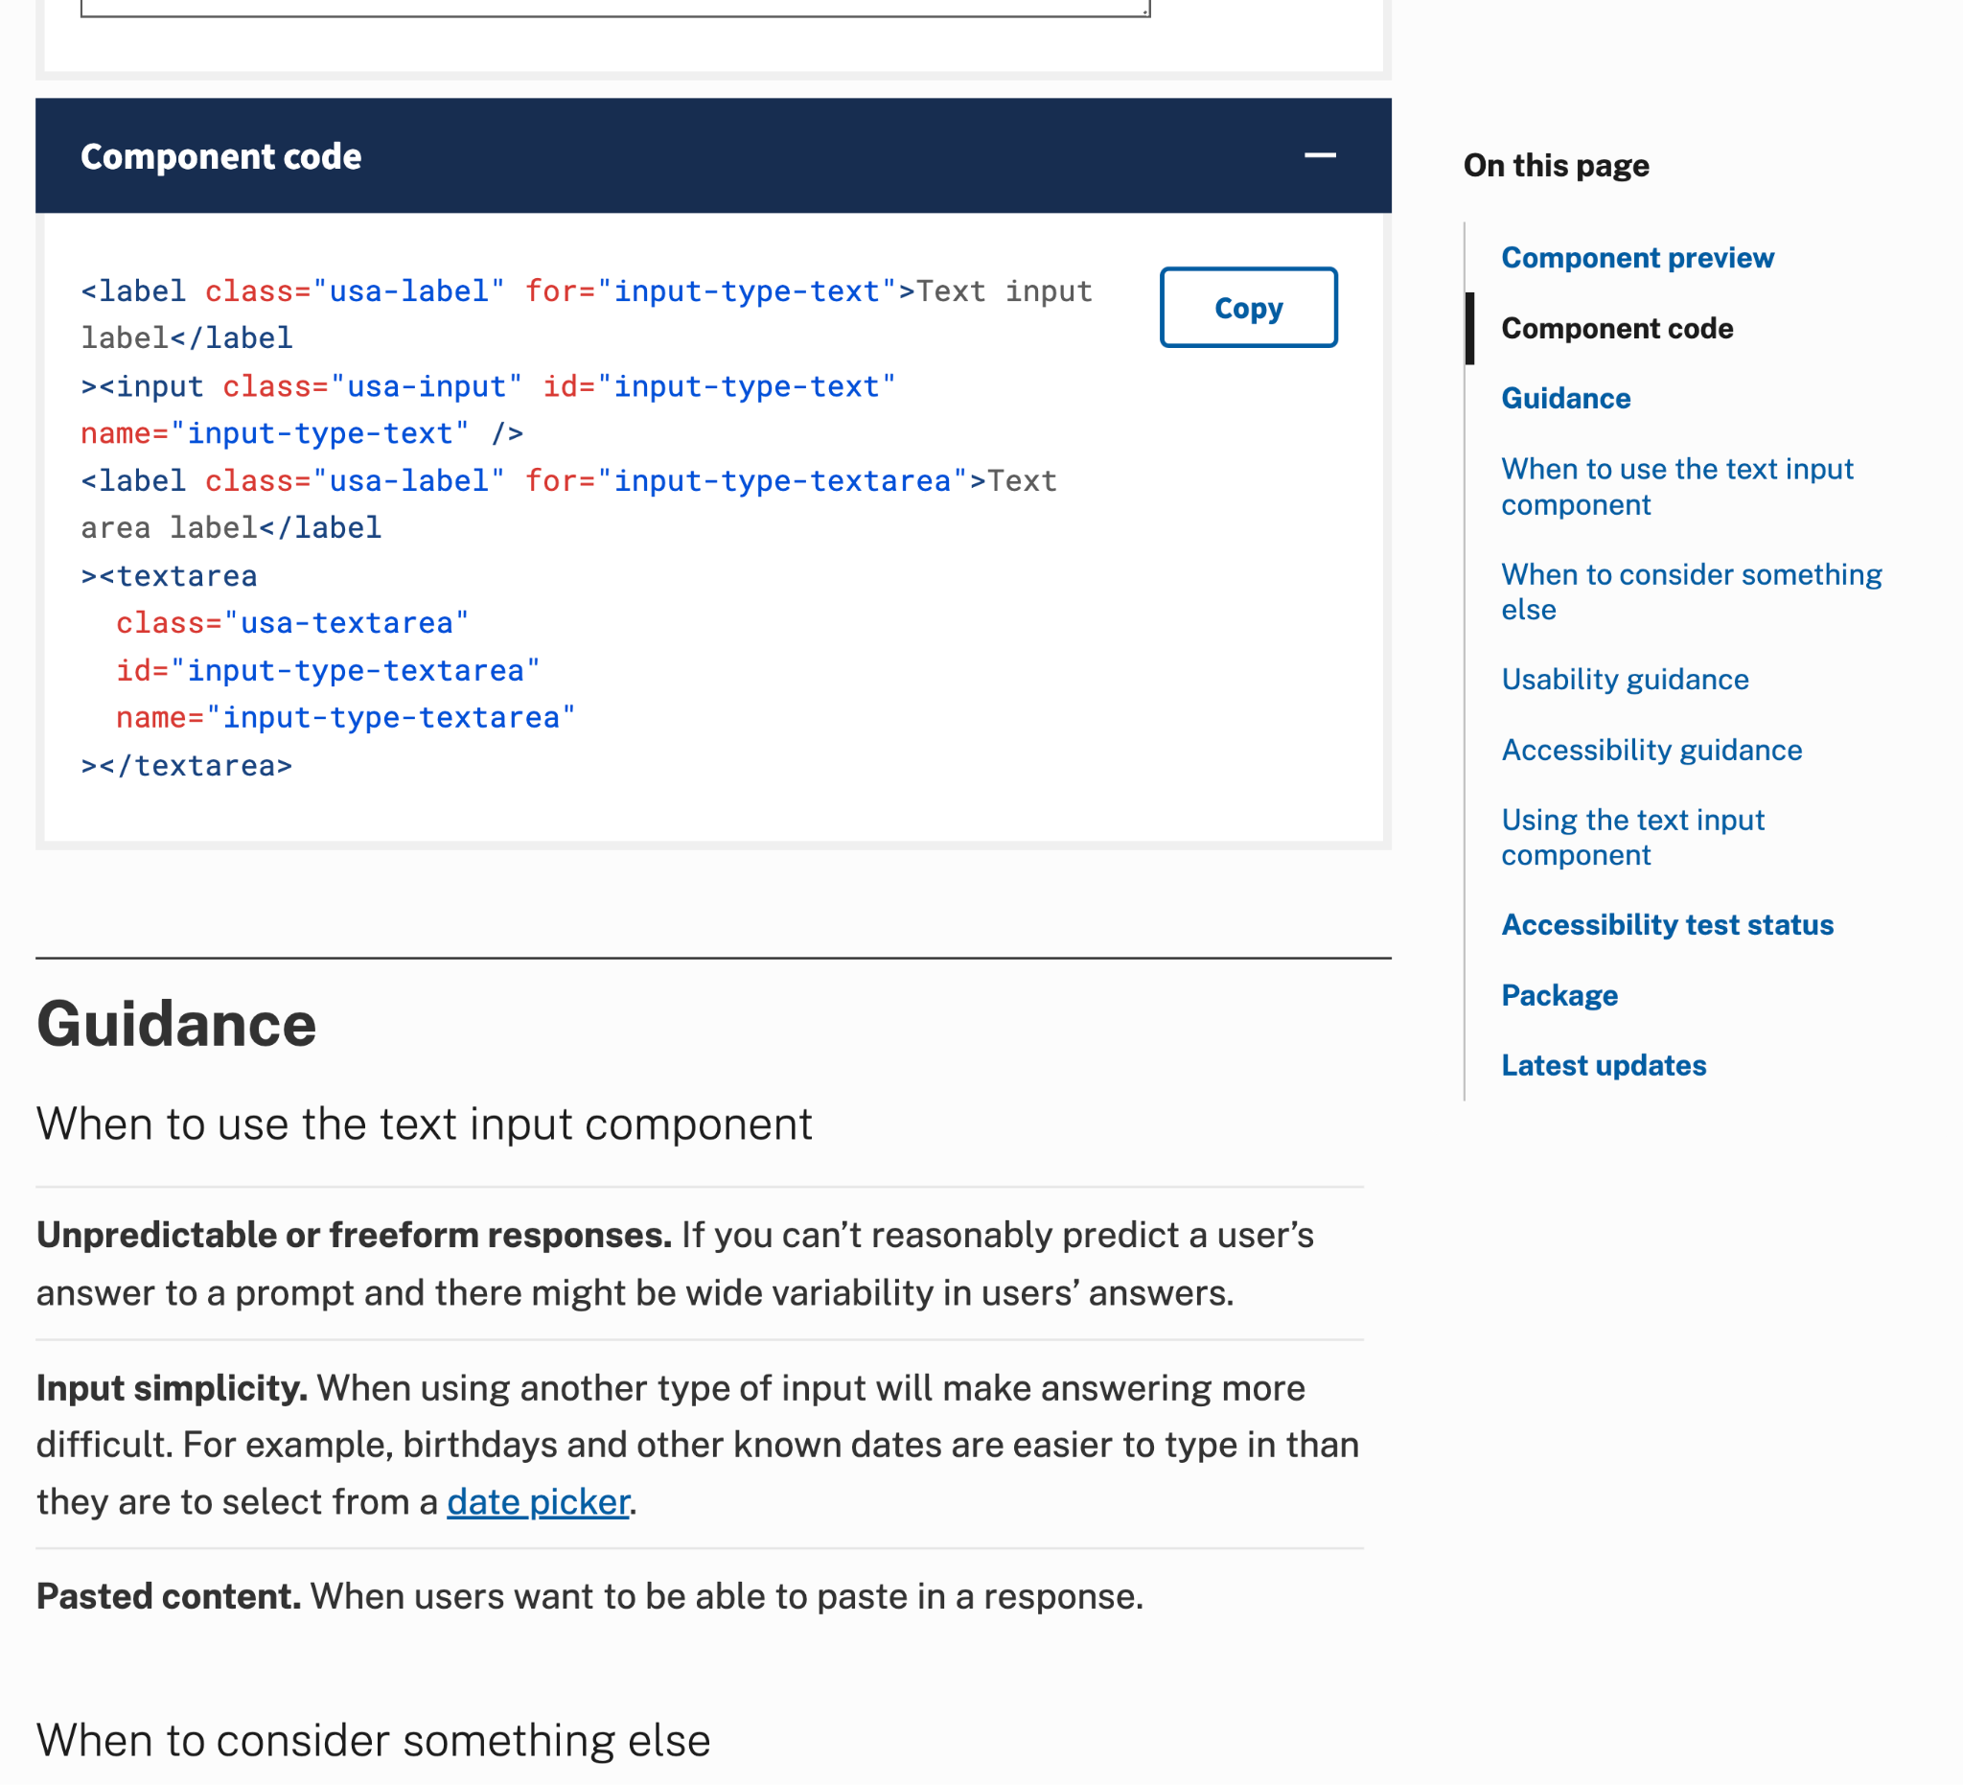
Component code
Text input component

Slide 52
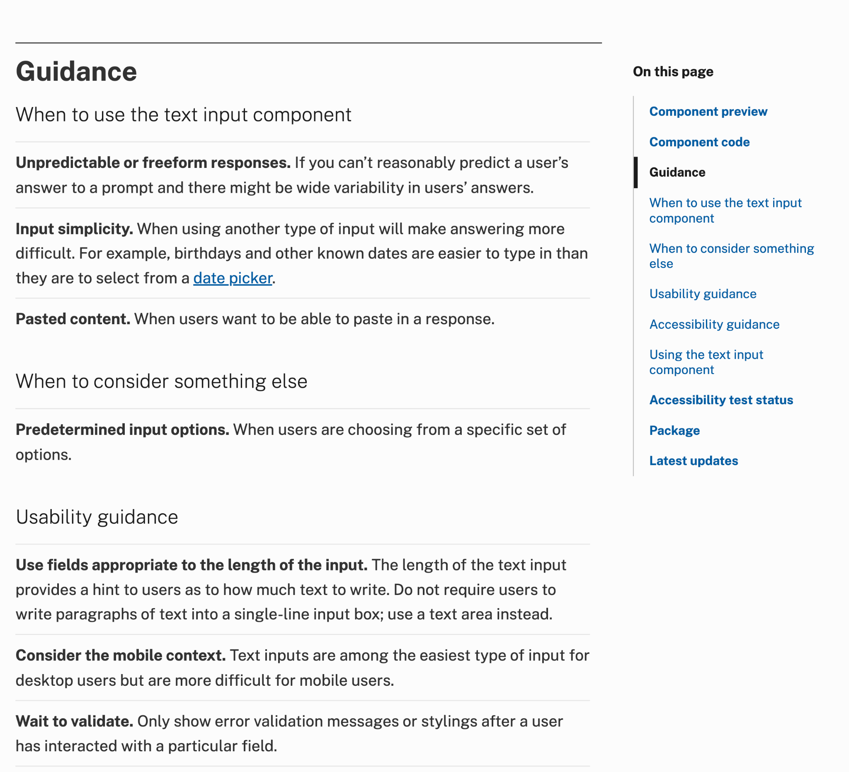
Component usability guidance
Text input component

Slide 53
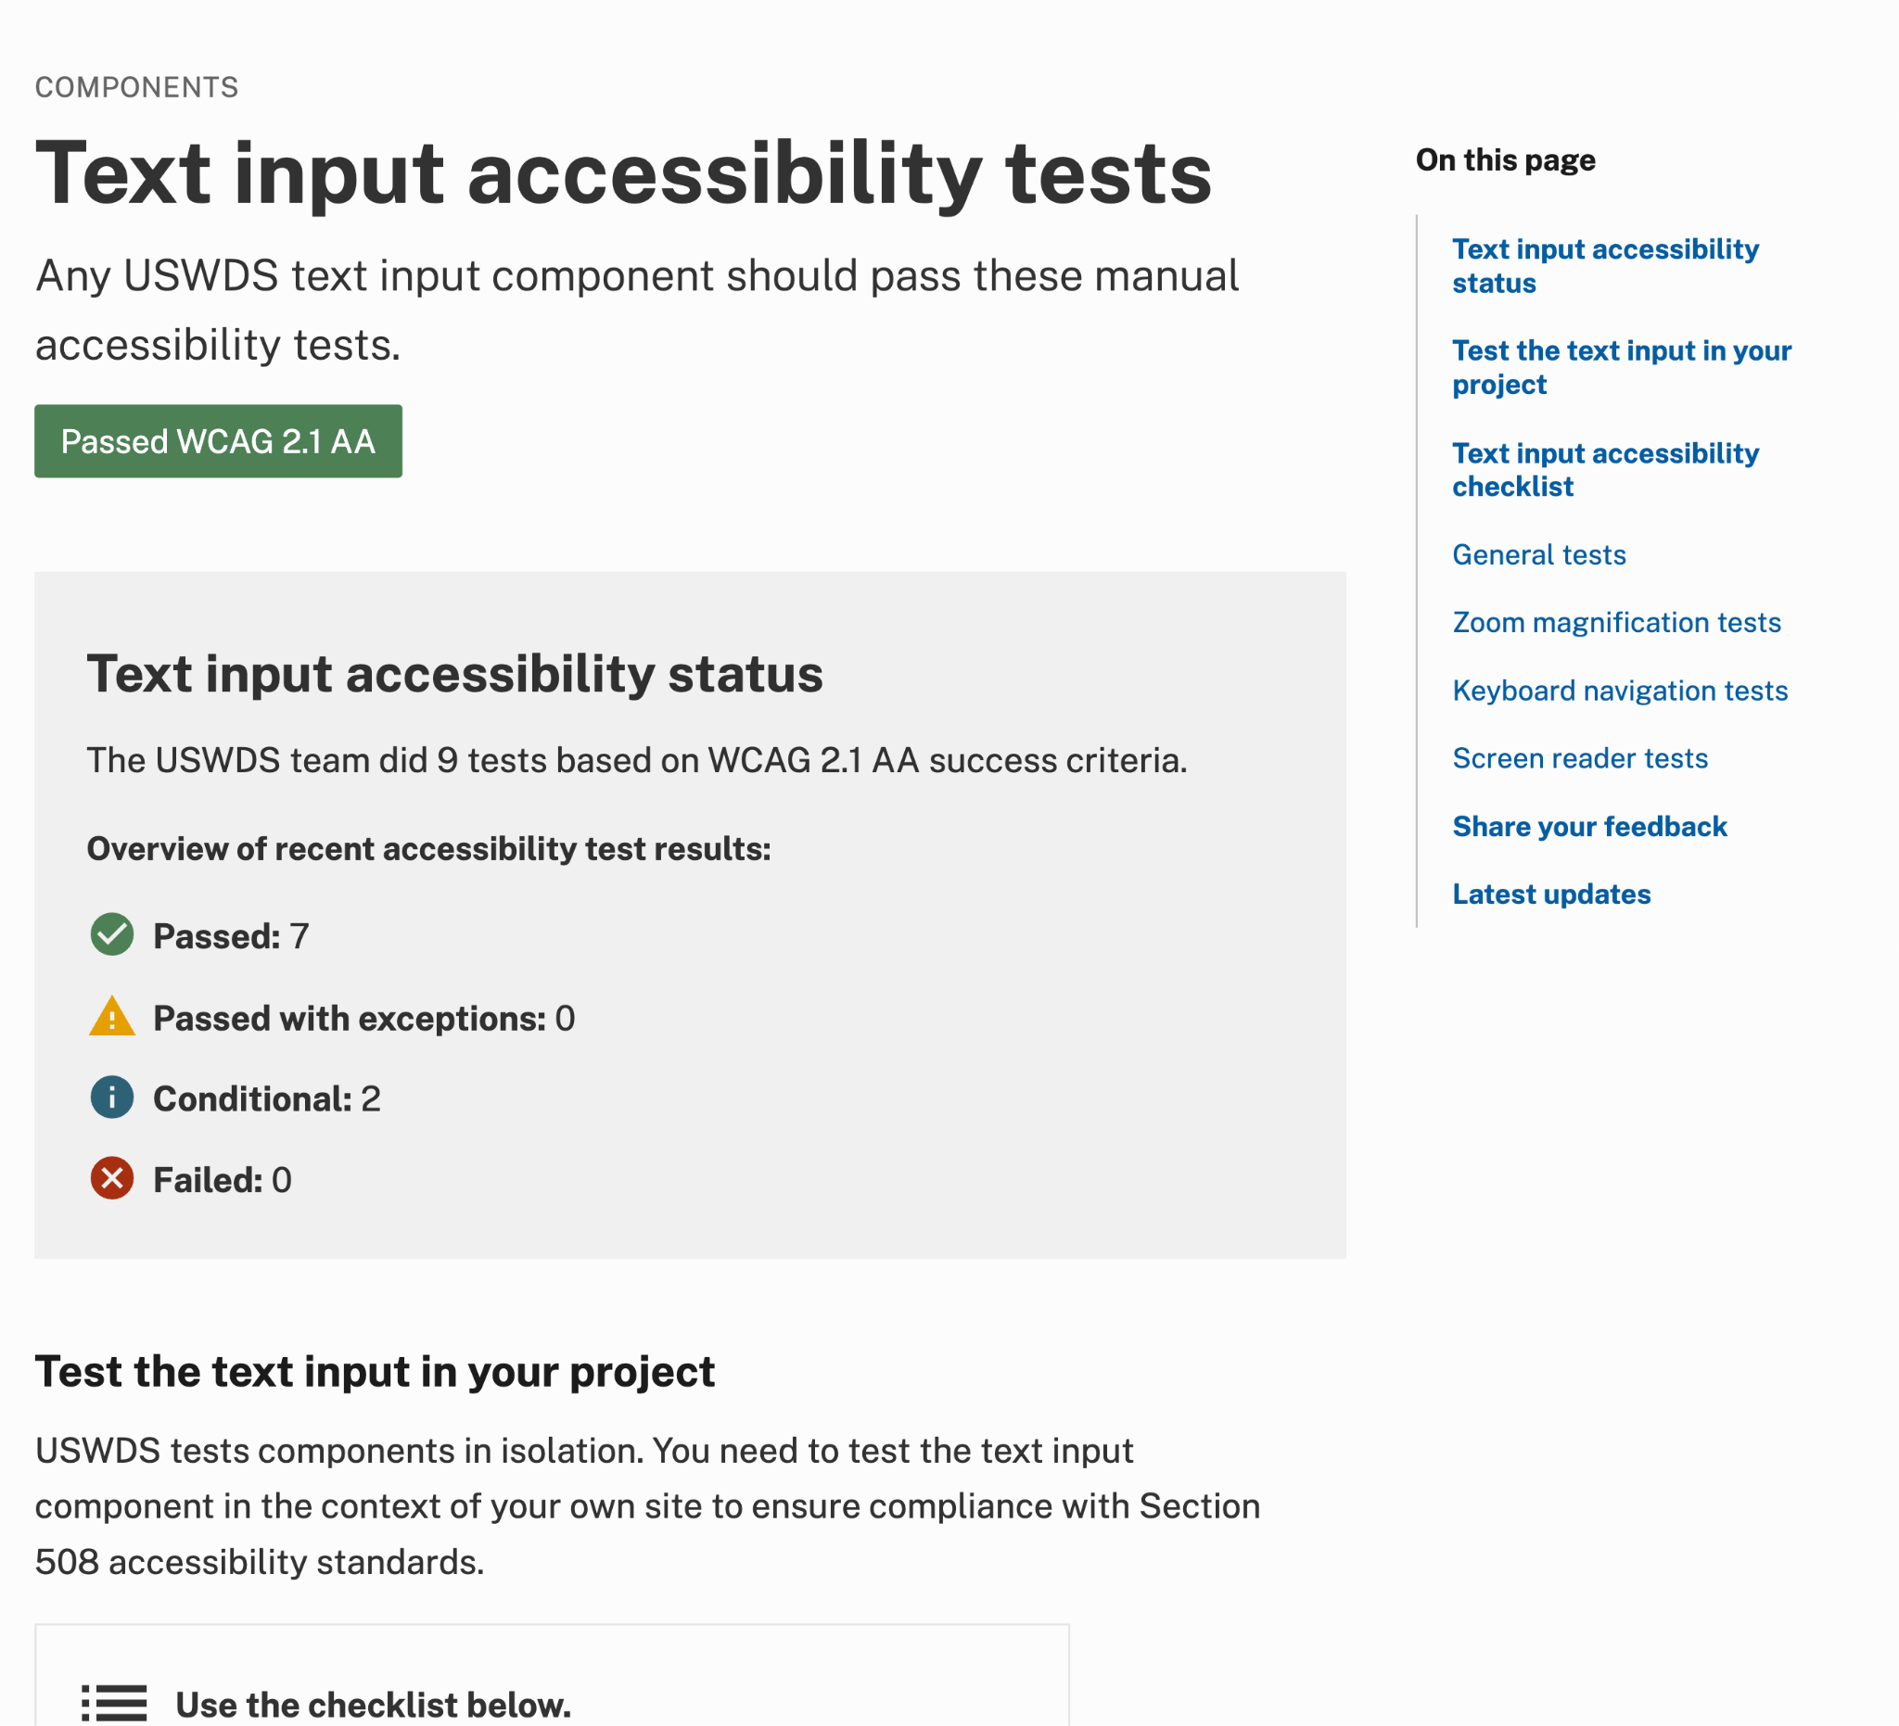
Accessibility tests
Text input accessibility tests

Slide 54
Design tokens
Palettes for simple design choices

Slide 55
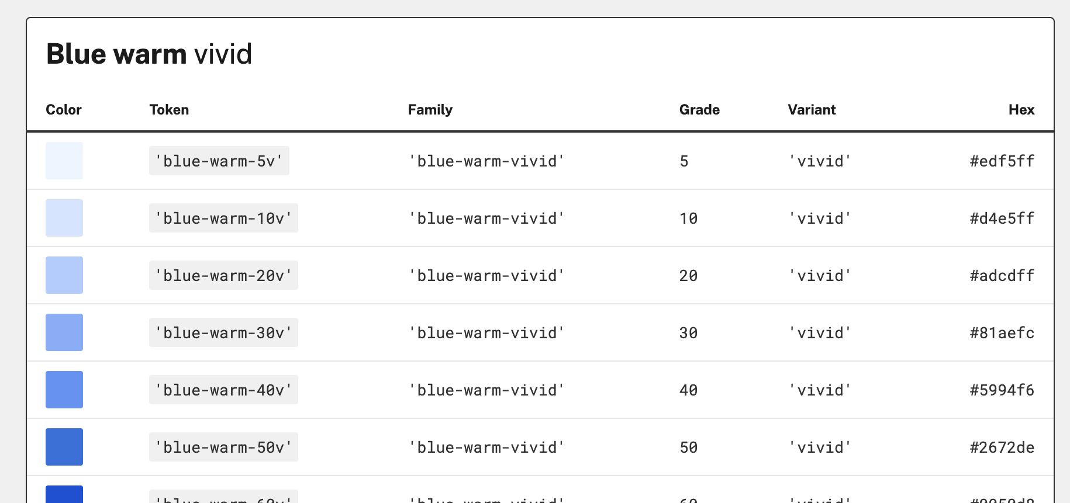
Color tokens

Slide 56
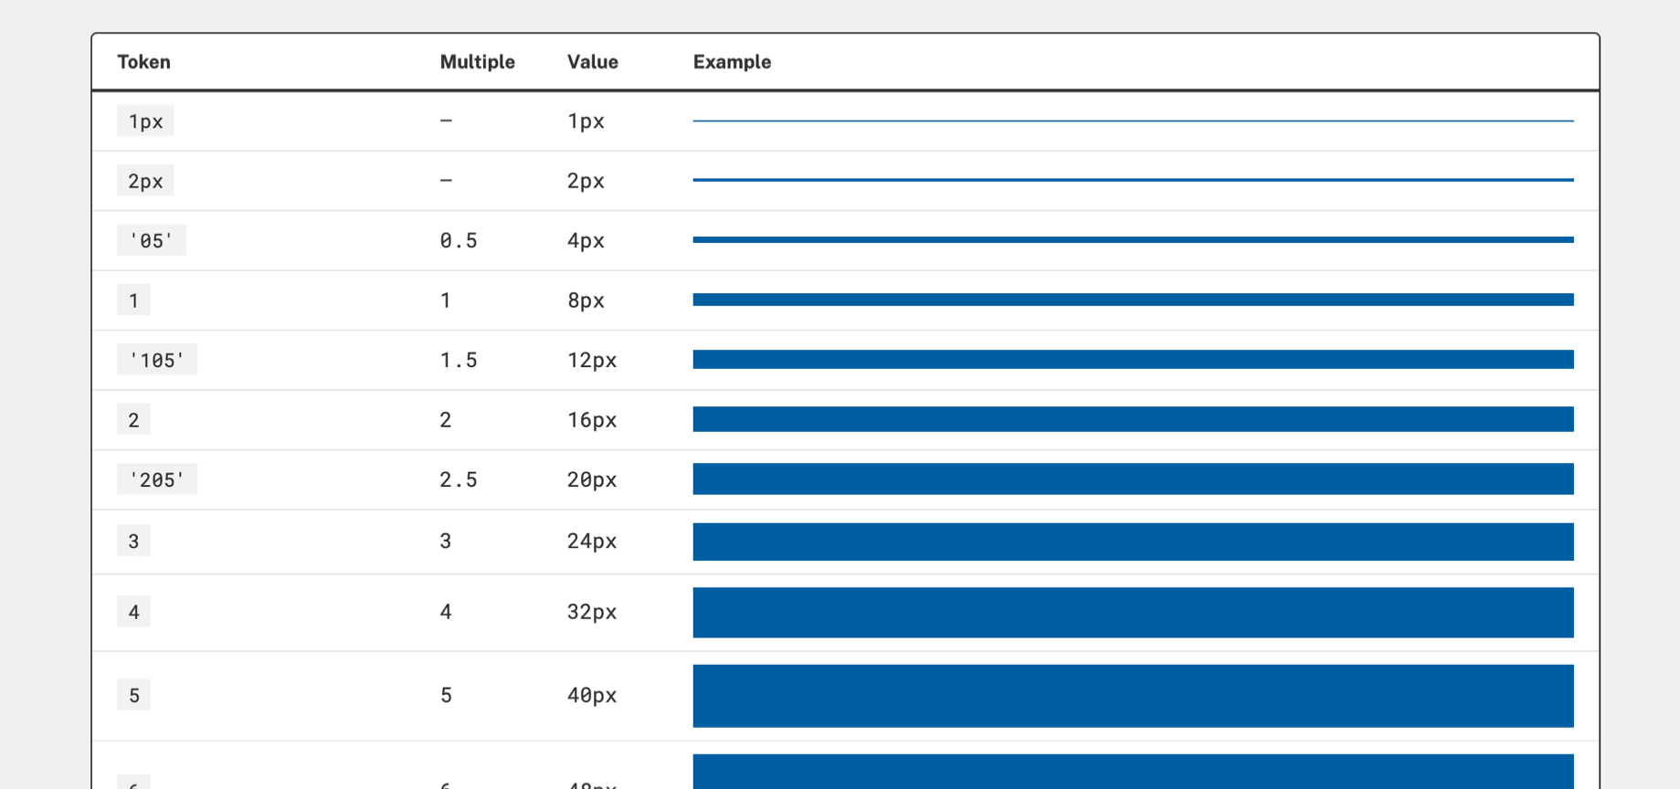
Spacing unit tokens

Slide 57
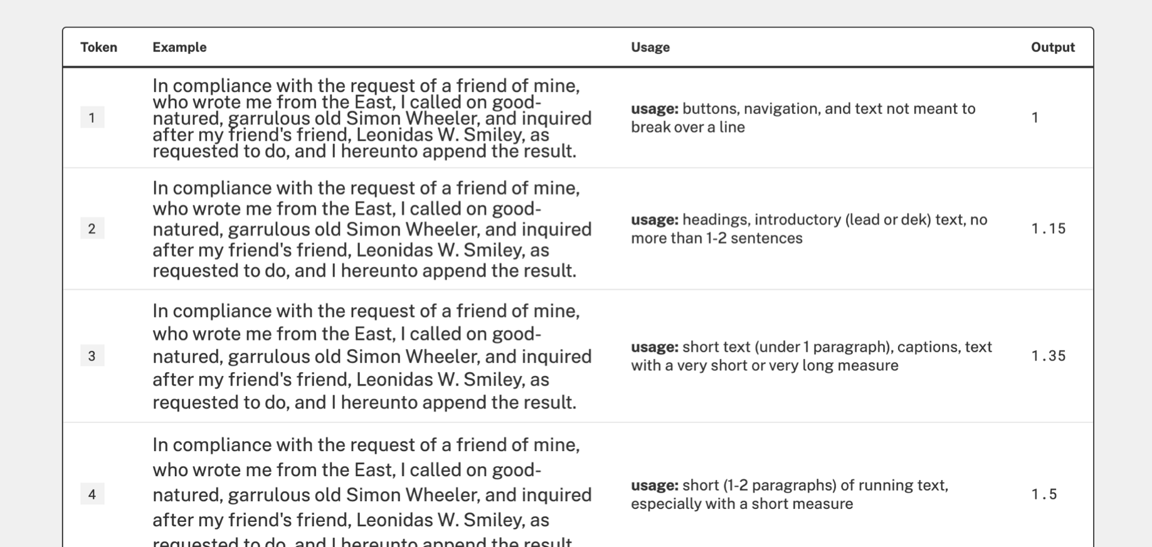
Line height tokens

Slide 58
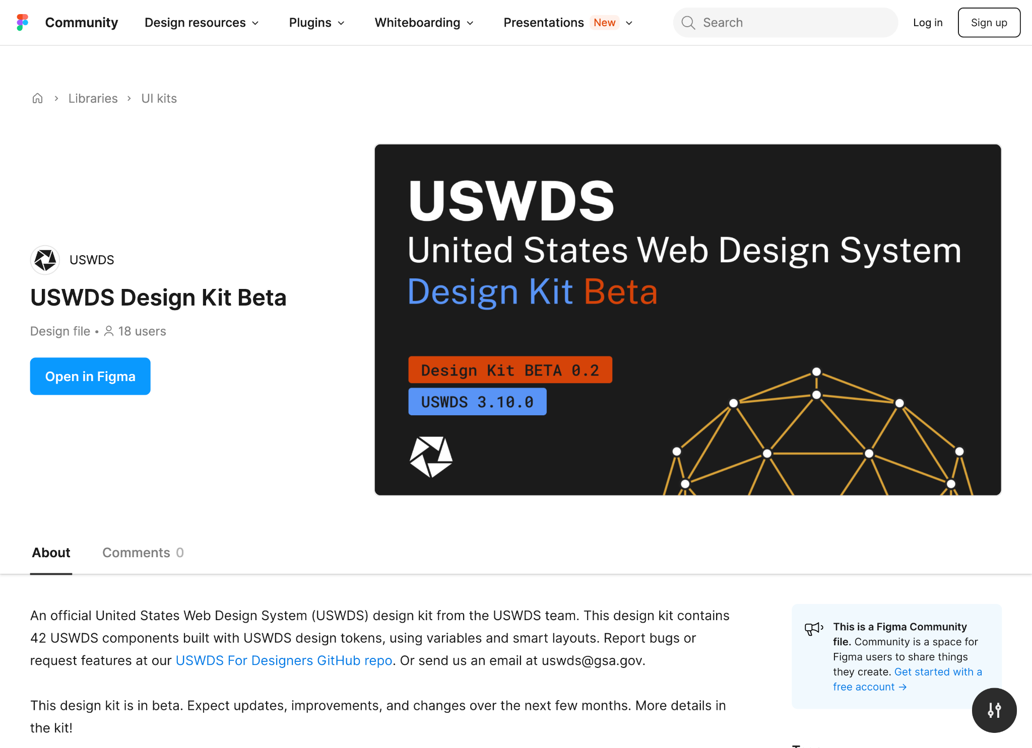
USWDS Figma kit beta available at figma.com/community

Slide 59
Work faster.
Prototype faster.
Share faster.
Improve faster.

Slide 60
Connect and contribute to an open-source project.

Slide 61
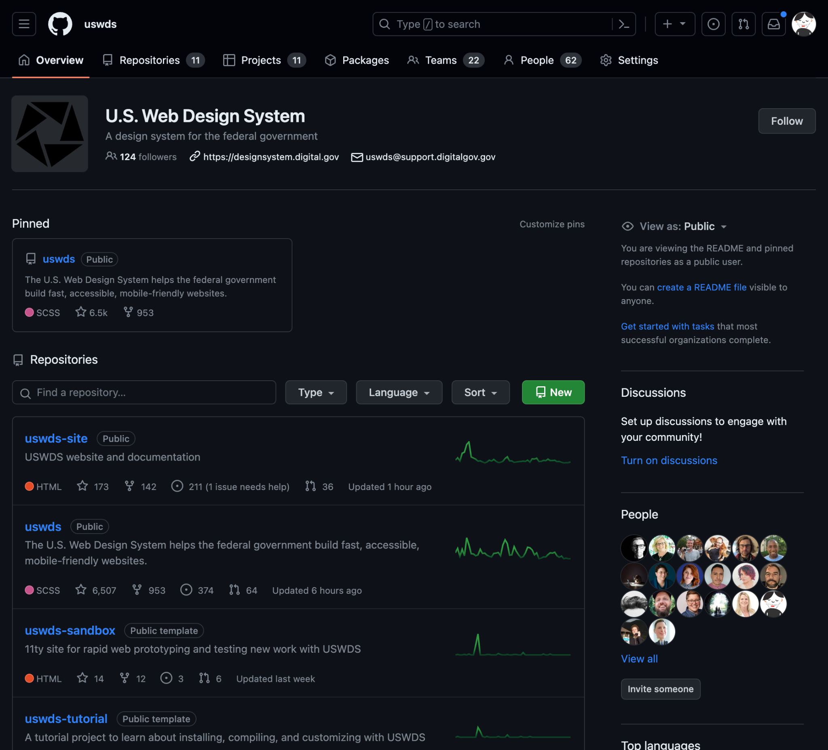
USWDS GitHub organization
github.com/uswds

Slide 62
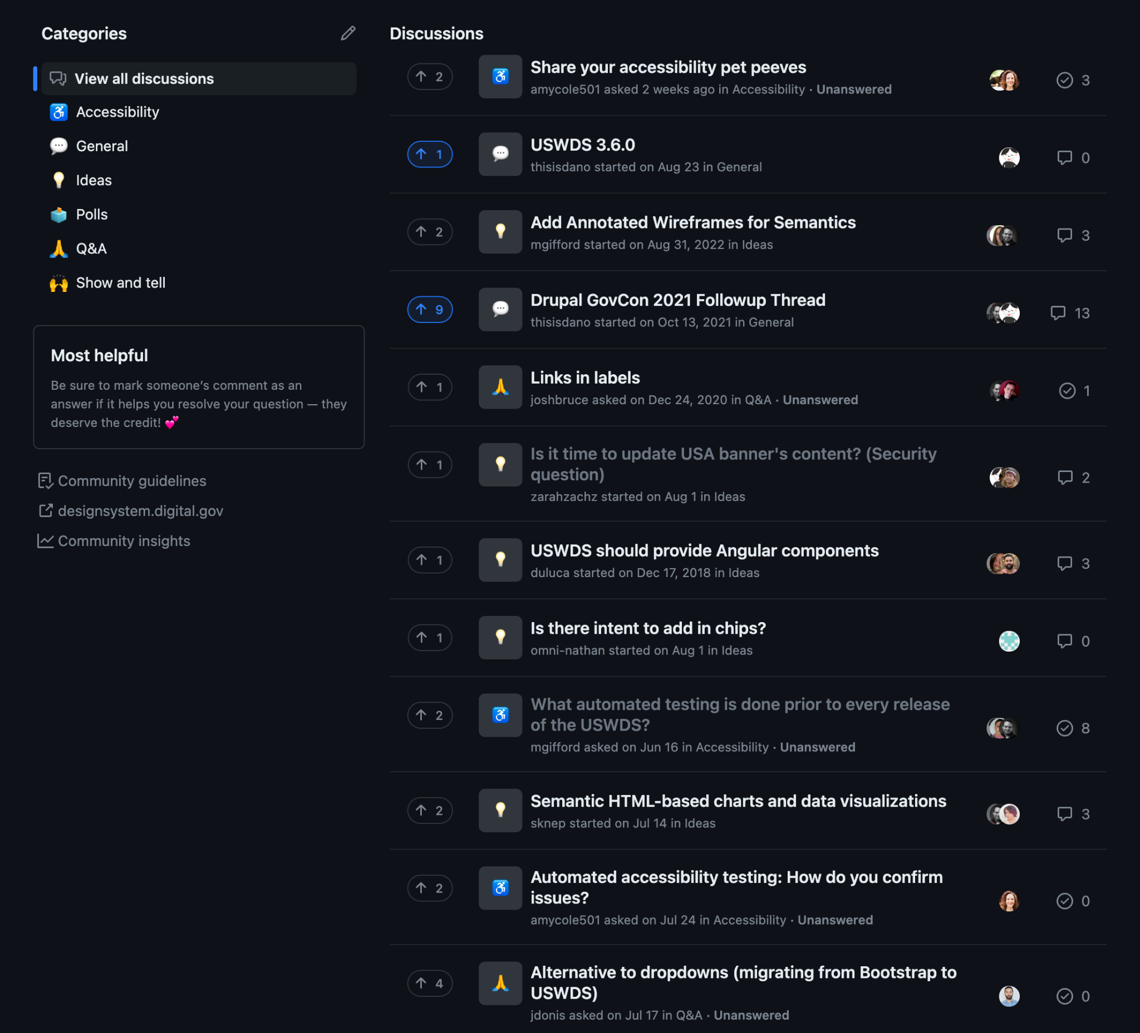
Current issues
github.com/uswds/uswds/discussions

Slide 63
USWDS public Slack
18f.gov/chat

Slide 64
USWDS monthly newsletter
Visit our website

Slide 65
USWDS monthly call
Third Thursday of each month

Slide 66
Getting started with USWDS

Slide 67
How do I add USWDS code to a project?

Slide 68
How do I just add the USWDS Banner??

Slide 69
How do I get started at all?!?

Slide 70
Demo 1

Slide 71
USWDS in 2025

Slide 72
Adding USWDS to a site can take a few steps
Notes:
[ new USWDS product we'll be introducing this spring: USWDS Elements. ]

Slide 73
How do I add USWDS code?
Installing
Connecting
Compiling
Composing
Refining
Notes:
[ new USWDS product we'll be introducing this spring: USWDS Elements. ]

Slide 74
What about a simpler USWDS?
Installing
Connecting
Compiling
Composing
Refining
Notes:
[ new USWDS product we'll be introducing this spring: USWDS Elements. ]

Slide 75
93 lines of banner code. So much we have to run it sideways!
<section
class="usa-banner"
aria-label="Official website of the United States government"
>
<div class="usa-accordion">
<header class="usa-banner__header">
<div class="usa-banner__inner">
<div class="grid-col-auto">
<img
aria-hidden="true"
class="usa-banner__header-flag"
src="/assets/img/us_flag_small.png"
alt=""
/>
</div>
<div class="grid-col-fill tablet:grid-col-auto" aria-hidden="true">
<p class="usa-banner__header-text">
An official website of the United States government
</p>
<p class="usa-banner__header-action">Here’s how you know</p>
</div>
<button
type="button"
class="usa-accordion__button usa-banner__button"
aria-expanded="false"
aria-controls="gov-banner-default"
>
<span class="usa-banner__button-text">Here’s how you know</span>
</button>
</div>
</header>
<div
class="usa-banner__content usa-accordion__content"
id="gov-banner-default"
>
<div class="grid-row grid-gap-lg">
<div class="usa-banner__guidance tablet:grid-col-6">
<img
class="usa-banner__icon usa-media-block__img"
src="/assets/img/icon-dot-gov.svg"
role="img"
alt=""
aria-hidden="true"
/>
<div class="usa-media-block__body">
<p>
<strong>Official websites use .gov</strong><br />A
<strong>.gov</strong> website belongs to an official government
organization in the United States.
</p>
</div>
</div>
<div class="usa-banner__guidance tablet:grid-col-6">
<img
class="usa-banner__icon usa-media-block__img"
src="/assets/img/icon-https.svg"
role="img"
alt=""
aria-hidden="true"
/>
<div class="usa-media-block__body">
<p>
<strong>Secure .gov websites use HTTPS</strong><br />A
<strong>lock</strong> (
<span class="icon-lock"
><svg
xmlns="http://www.w3.org/2000/svg"
width="52"
height="64"
viewBox="0 0 52 64"
class="usa-banner__lock-image"
role="img"
aria-labelledby="banner-lock-description-default"
focusable="false"
>
<title id="banner-lock-title-default">Lock</title>
<desc id="banner-lock-description-default">Locked padlock icon</desc>
<path
fill="#000000"
fill-rule="evenodd"
d="M26 0c10.493 0 19 8.507 19 19v9h3a4 4 0 0 1 4 4v28a4 4 0 0 1-4
4H4a4 4 0 0 1-4-4V32a4 4 0 0 1 4-4h3v-9C7 8.507 15.507 0 26 0zm0
8c-5.979 0-10.843 4.77-10.996 10.712L15
19v9h22v-9c0-6.075-4.925-11-11-11z"
/>
</svg> </span
>) or <strong>https://</strong> means you’ve safely connected to
the .gov website. Share sensitive information only on official,
secure websites.
</p>
</div>
</div>
</div>
</div>
</div>
</section>
Notes:
[AP] Often, one of the biggest obstacles to solving a problem isn't too many constraints...

Slide 76
What if it was one line? With no compiling?
<usa-banner></usa-banner>
Notes:
[AP] Often, one of the biggest obstacles to solving a problem isn't too many constraints...

Slide 77
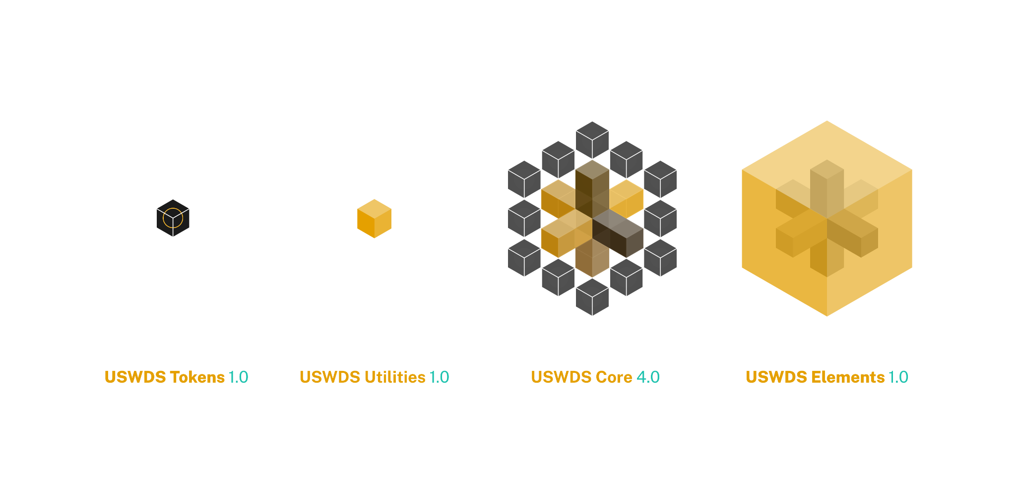
USWDS Elements

Slide 78
USWDS Elements is best for:
Teams with fewer design resources
Teams that don’t need as much customization
Teams that want to reduce complexity
Teams experimenting with USWDS

Slide 79
Demo 2

Slide 80
USWDS
Web Components
PROJECT TEAMS
Reduced project maintenance costs Reduced upgrade burden
Reduced compliance burden Improved project velocity Improved mission focus

Slide 81
Coming Spring 2025
Core HTML components
USWDS Core 4.0
Web Components
USWDS Elements 1.0

Slide 82
USWDS 3 → USWDS Core 4.0

Slide 83
USWDS Core is best for:
Teams with a mature design practice
Teams with existing USWDS implementations
Teams that need more customization
Teams that want to build new things

Slide 84
USWDS in 2025
More options. Easier to install. Easier to stay up-to-date.

Slide 85
Onward!

Slide 86
Thank you!

Slide 87
Q&A

Slide 88
Next month
February: Core, Elements, and Tokens
#uswds-public
github.com/uswds
designsystem.digital.gov

Slide 89
Disclaimer: All references to specific brands, products, and/or companies are used only for illustrative purposes and do not imply endorsement by the U.S. federal government or any federal government agency.

